Slide 1
MEDI Script:
Transforming unstructured clinical notes into actionable Using Unix/Linux Command-Line Scripts
Journal Reference: Extracting adverse drug events from clinical notes: A systematic review of approaches used (DOI Link)
This article highlights the importance of efficient text processing for uncovering hidden patterns in clinical data.
Author: Victor Owino
2

Slide 2
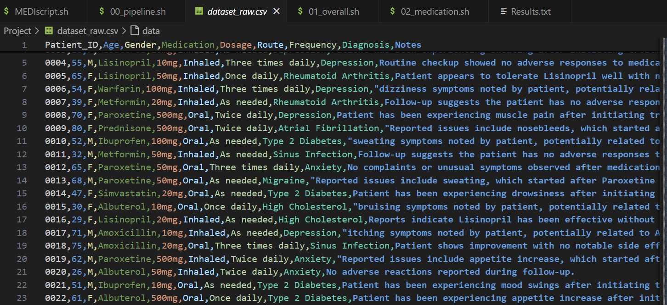
Overview of Raw Dataset
Important information reported by patients is often ignored unless the doctor has enough time to thoroughly review it, which typically requires more than two visits.
In most cases, these notes are frequently written by different practitioners, and electronic health records (EHR) systems lack the ability to summarize or flag key issues effectively.
My project aims to extract this critical information, enabling faster and more accurate prognoses and diagnoses, surpassing the efficiency of manual review by humans.
2

Slide 3
Objective:
This project aims to develop a pipeline for preprocessing, filtering, and extracting relevant insights from unstructured text like clinical notes within electronic health records (EHRs)
2

Slide 4
Research Questions
Can text preprocessing tools help us derive meaningful insights from clinical notes?
Given clinical discharge notes, can we determine the prevalence of adverse drug events (ADEs)?
Which patient demographics (age, gender) are most frequently associated with specific ADEs?
Which medications are most commonly linked to ADEs, and what types of ADEs are associated with each medication?
2

Slide 5
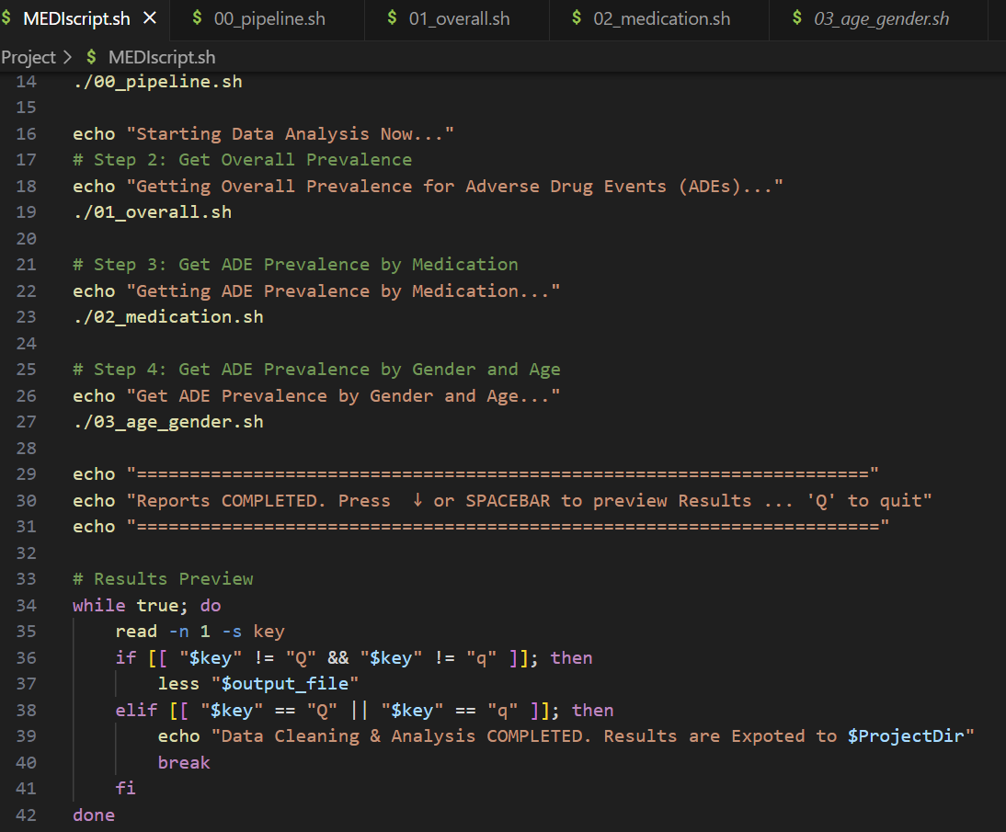
Methodology Overview
Unix/Linux command-line utilities: grep, sed, tr, awk, cut
00_pipeline.sh: Script to preprocess the text data for analysis.
01_overall.sh: Answers the first research question about the overall prevalence of adverse drug events (ADEs).
02_medication.sh: Produces frequency counts of ADE prevalence by the type of medication administered.
03_age_gender.sh: Produces frequency tables of ADE prevalence by gender and age group.
MEDIScript.sh: The main execution script that runs all the above scripts at once and generates the report in a text file.
2

Slide 6
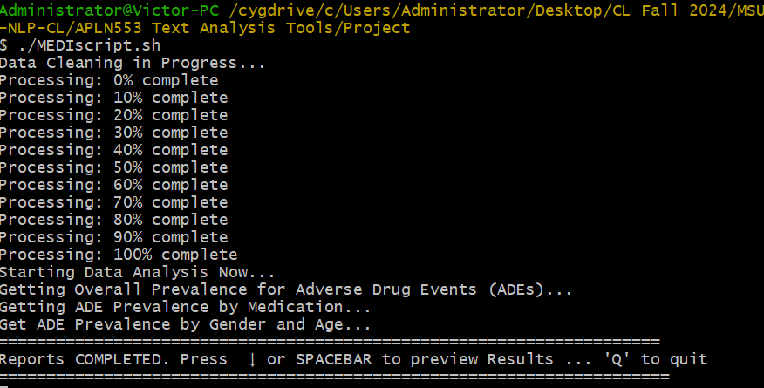
Results
MEDIScript.sh
The main execution script that runs all the above scripts at once and generates the report in a text file.
2

Slide 7
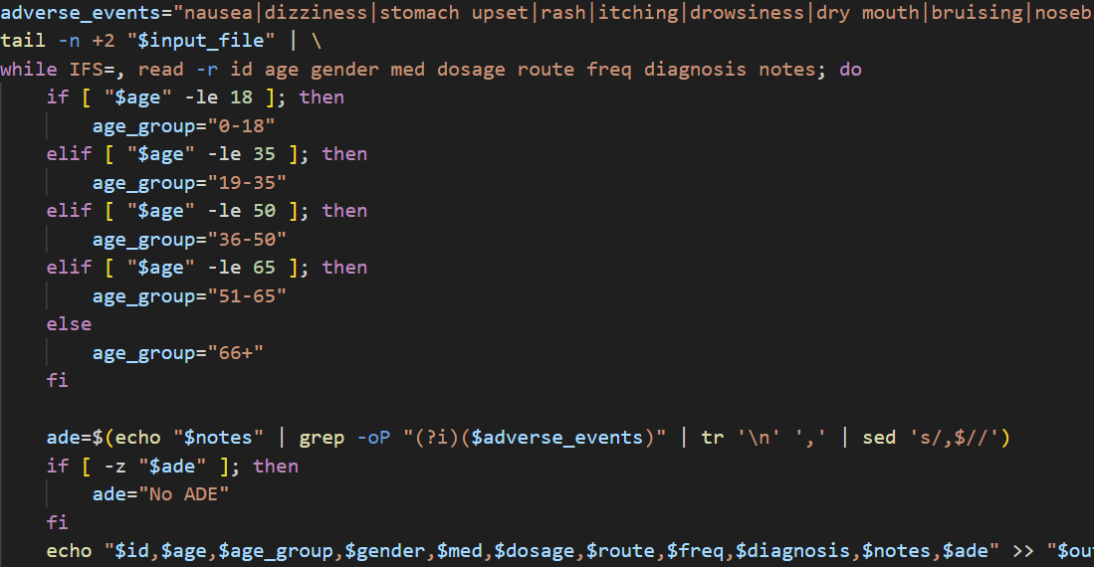
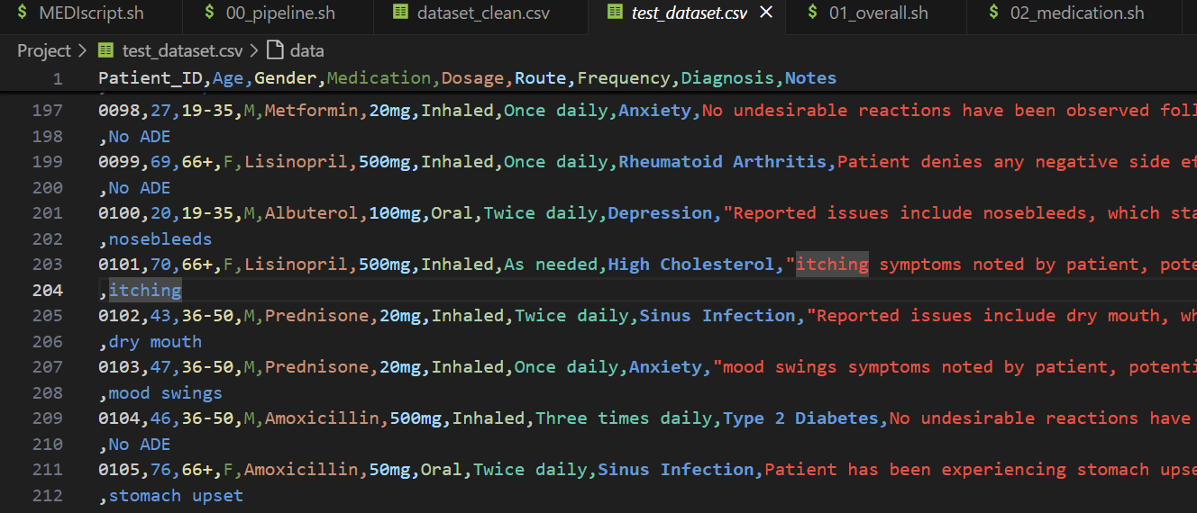
Results
00_pipeline.sh:
00pipeline.sh: Script to preprocess the text data for analysis call clean_dataset.csv
2

Slide 8
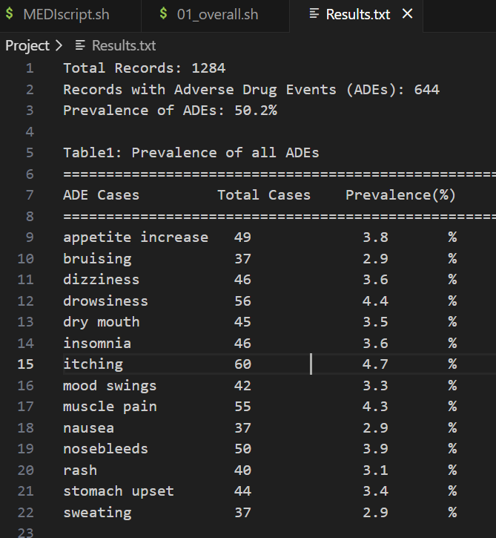
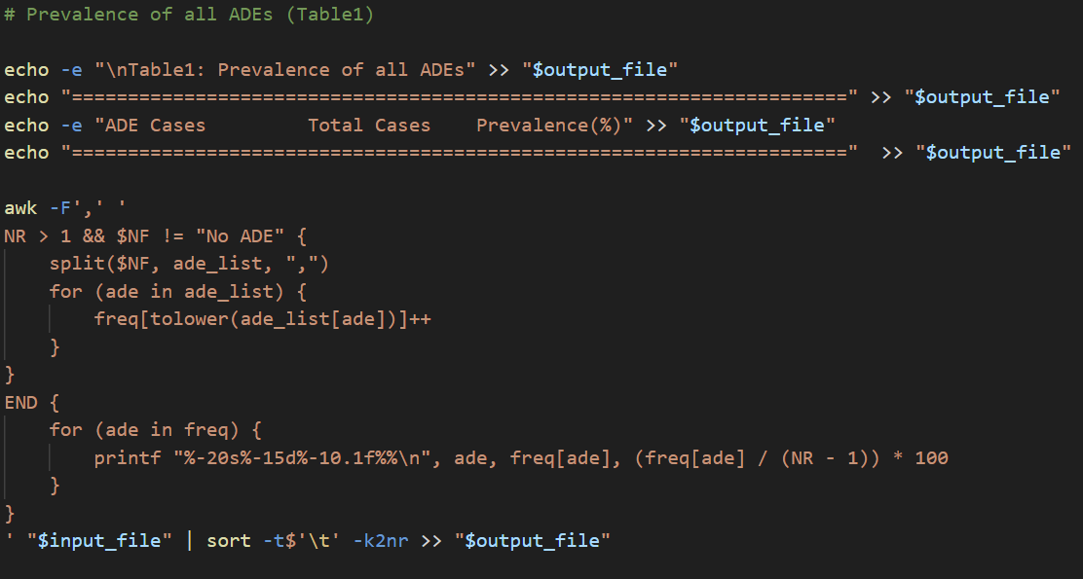
Results
01_overall.sh :
Answers the first research question about the overall prevalence of adverse drug events (ADEs).
2

Slide 9
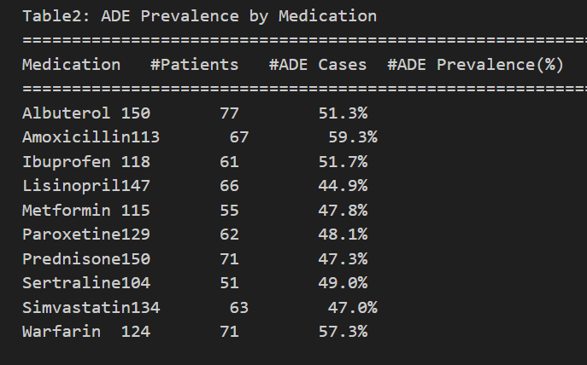
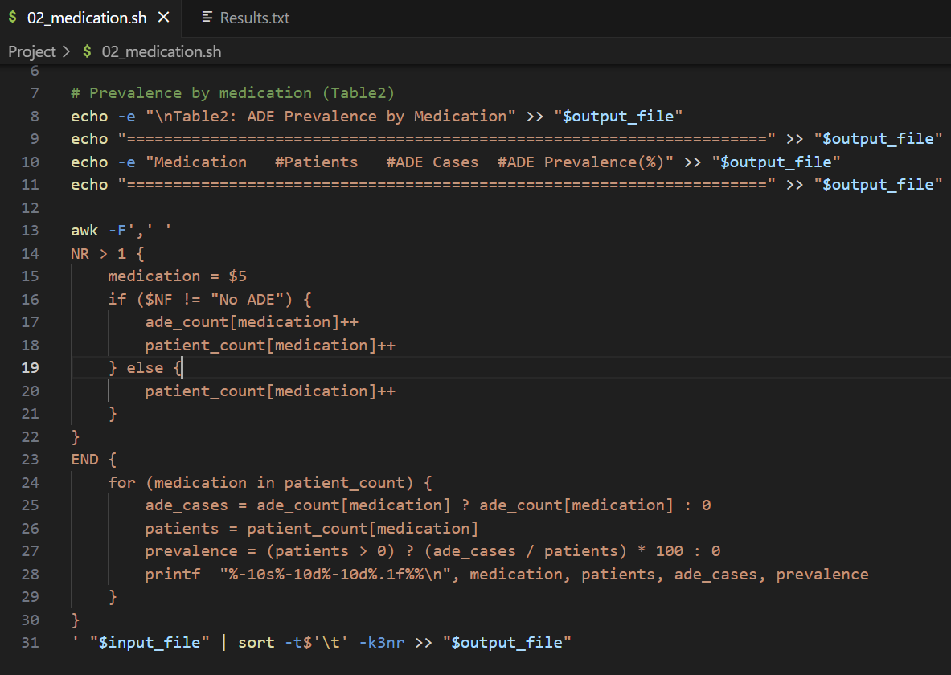
Results
02_medication.sh:
Produces frequency counts of ADE prevalence by the type of medication administered.
2

Slide 10
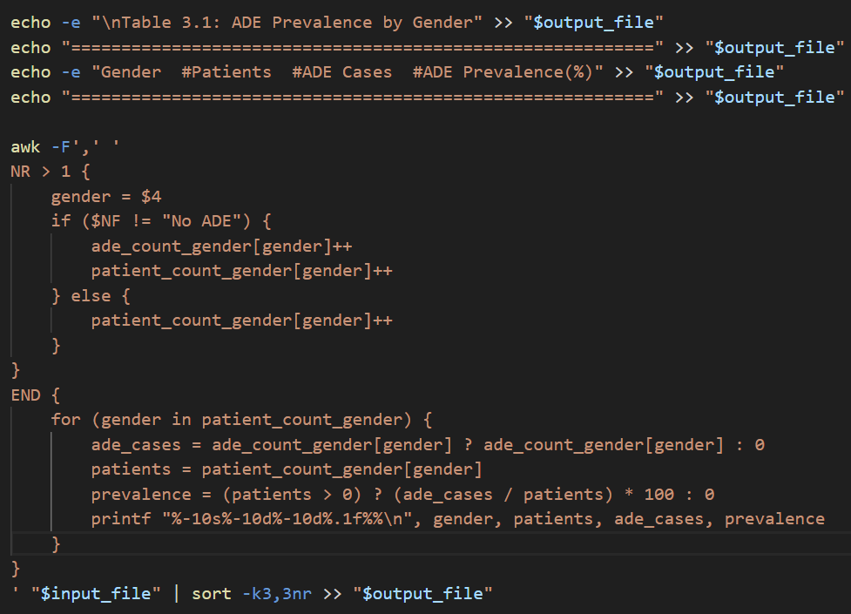
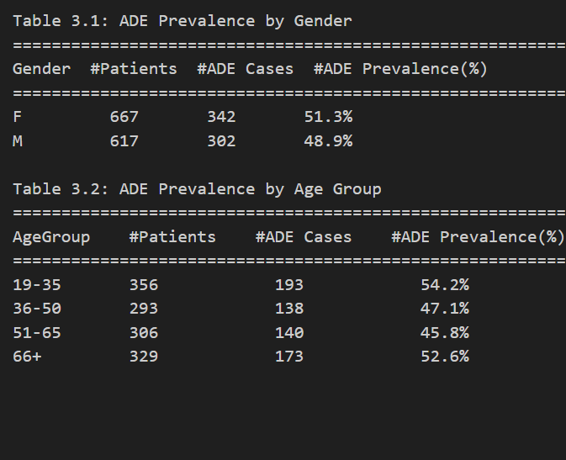
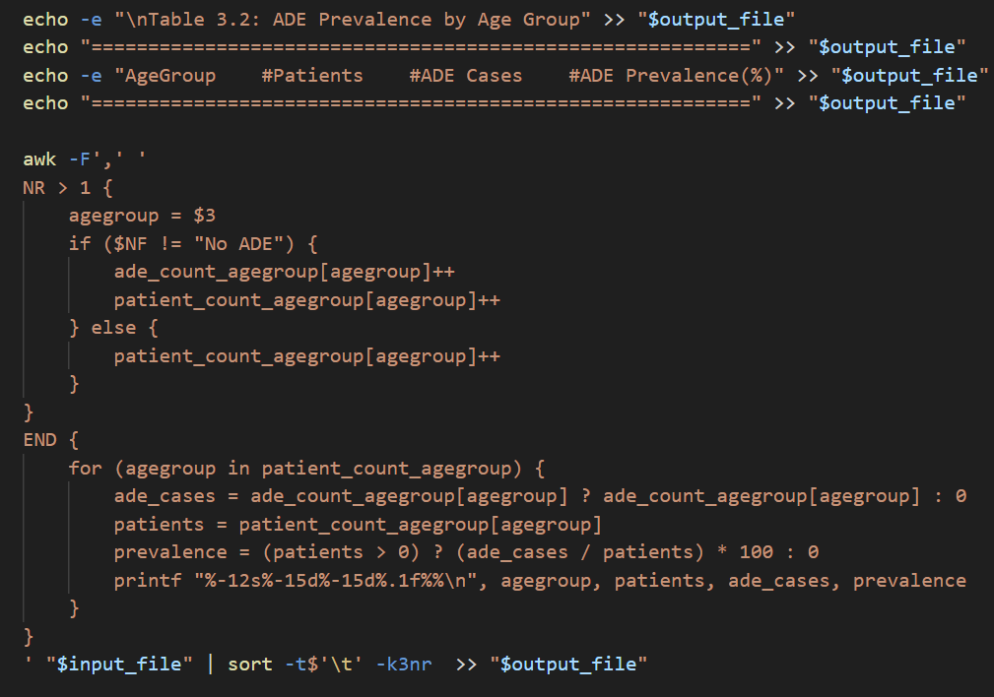
Results
Produces frequency tables of ADE prevalence by gender and age group.
03_age_gender.sh:
2

Slide 11
Conclusion
While we are able to Extract some insights using only Linux Utilities, they are only ahs good for basic text preprocessing.
The recognition of negation modifiers represents an important challenge.
Moving Forward
I hope to leverage advanced NLP techniques with dense representations (embeddings) and incorporating attention mechanisms solve negation recognition.
2

